Slide 1
Pong Game 6S Project
MINE Vincent
ABRY-COMBE Mathieu
LE SOMMER Léo
COISSARD Kévin
ASPE 2015-2016

Slide 2
Summary
What’s we had to define :
Our project
Game’s features
Constraints
Tasks distribution
Make the Game :
Objects (Ball, paddles, box)
Functions (Movements, IA, score)
Graphics/Sounds
Finally : What we learnt
Brainstorming
Leaderbord

Slide 3
Additionnal features Brainstorming
8 WEEKS
Score
Gameplay
Graphical interface
Buttons
Screen
Classical Game
1vs Bot
2 balls
Multiplayer
Objects
Graphics
Bar bonus
2 player
Spaces textures
Logo
Basis
Bonus
Median Line
Easy to do

Slide 4
Progress : What we did in 8 weeks
Score
Gameplay
Graphical interface
Buttons
Screen
Classical Game
1vs Bot
2 balls
Multiplayer
Objects
Graphics
Bar bonus
2 player
Space textures
Logo
Done
Not finished
Median Line

Slide 5
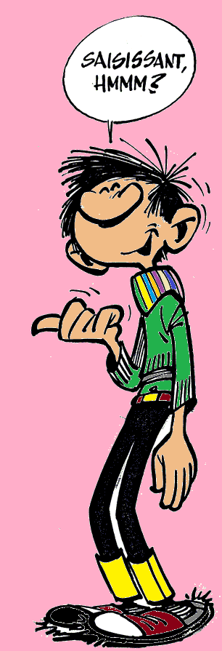
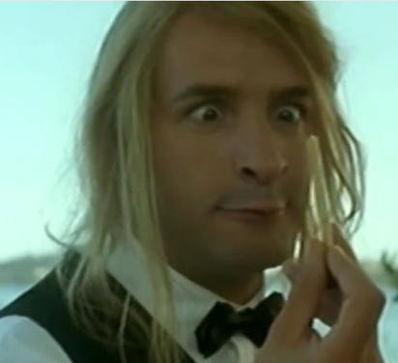
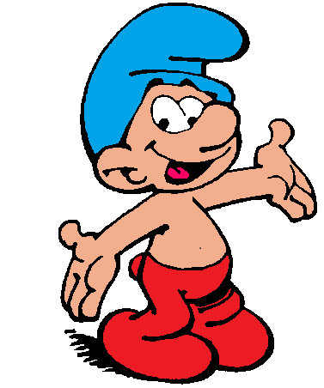
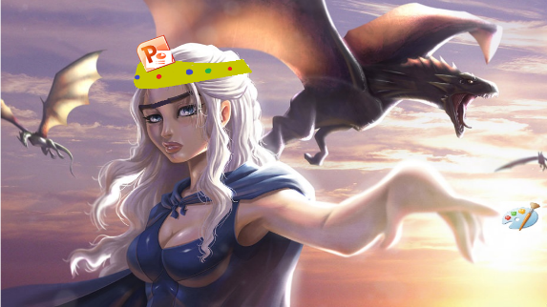
Tasks distribution
Vincent : Developer, Model assistant Geometrics objects classes UML (models) Help to take decisions | Mathieu : Overpaid Manager, Sound Ingeneer Project Organization Define tasks Sound effects Language reviewer
Léo : CodeMaster, Model creator Display Game mecanisms Objects Movements Collisions | Kévin : God of Paint, first Queen of Powerpoint mascot and secretary Project Organization PWP Textures (Bar/ball) Logo Wallpaper

Slide 6


Slide 7
Let’s try it !
DEMO

Slide 8
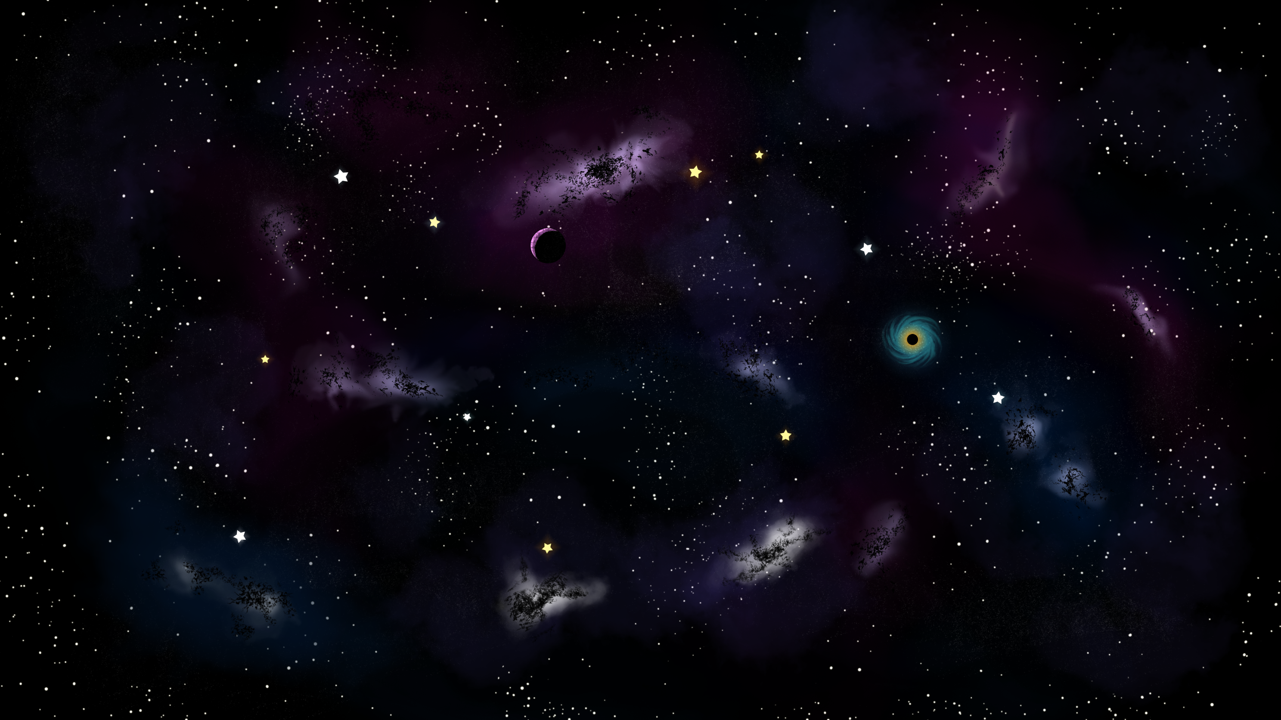





Textures
Sounds
Theme
Bonus effect
Ball
Collision
Logo
Goal
The bar

Slide 9
Difficulties
Organize our team with everyone qualities and “shortcoming”
Talk about technical things in English, find vocabulary
Steps to follow in order to make a game
Theoretical knowledge lack
We don’t know Python, find a way to convert Java in python.

Slide 10
Conclusion : What we have learnt
Discover & Use a Raspberry Pi
Organize a project with differents skills in english
Do a useful Brainstorming
All aspects of a game (Project leading, Development, Sounds, Graphics)
Create sounds and textures

Slide 11

Thanks for listenning !
MINE Vincent
ABRY-COMBE Mathieu
LE SOMMER Léo
COISSARD Kévin

